Slide 1


STATISTICS AND EDA
INT351

Slide 2

CONTENTS
UNIT I
EDA Introduction, Public and Private Data, Web Scraping, Data Types, Fixing rows & columns, input/missing values, handling outliers, standardizing values, fixing invalid values and filtering data
UNIT II
UNIVARIATE ANALYSIS Introduction, Categorical Unordered – Ordered, Statistics on Numerical Features, Numeric-Numeric Analysis, Correlation vs Causation, Numerical-Categorical Analysis, Categorical-Categorical Analysis, Multivariate Analysis, Missing Values, Data Visualization
UNIT III
INFERENTIAL STATISTICS – 1 Permutations, Combinations, Probability

Slide 3

INTRODUCTION TO EDA
Exploratory Data Analysis (EDA) is a data science technique that involves analyzing and summarizing datasets to uncover patterns, trends, and insights.
It s a crucial step in data science and is used to extract vital features and trends used by machine learning and deep learning models.
A key component of EDA is data visualization, which is the graphical representation of data using plots, charts, and graphs. For example, you can use EDA to visualize data to find that most customers buy 1-3 different types of shoes.
EDA uses a variety of techniques, mostly graphical, to:
Maximize insight into a data set
Uncover underlying structure
Extract important variables
Detect outliers and anomalies

Slide 4
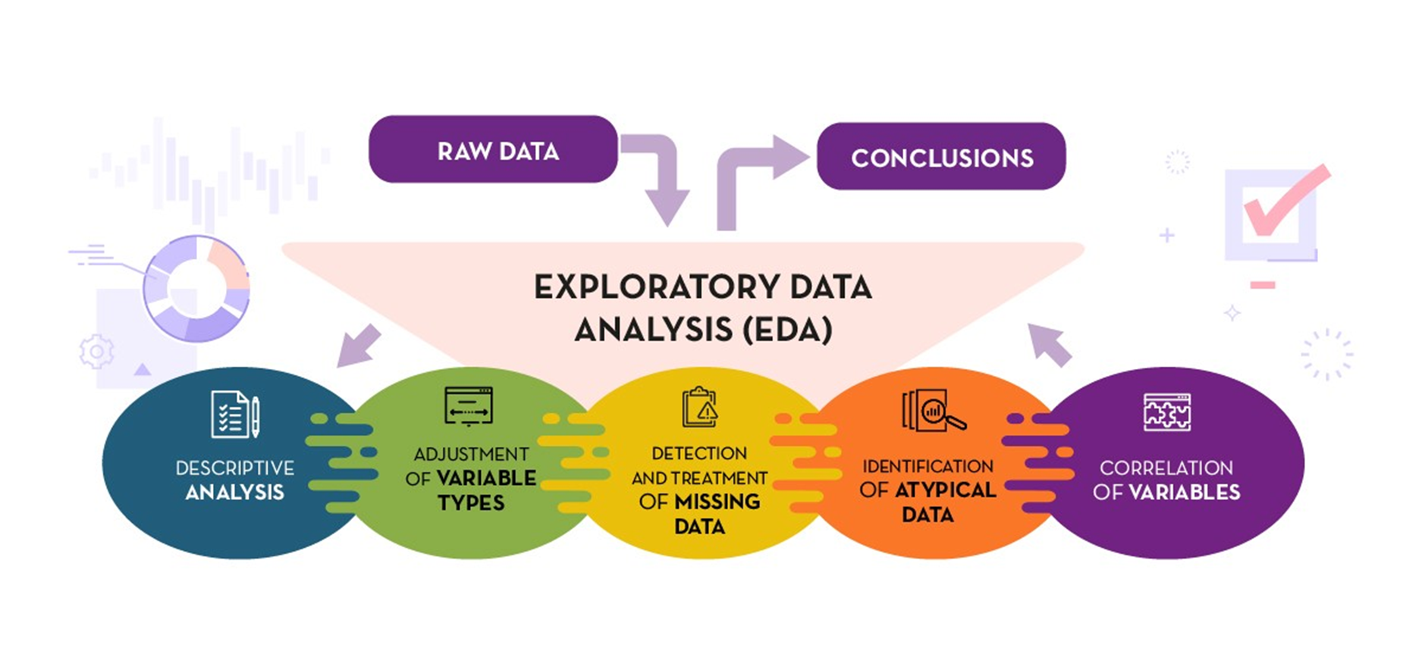
Overview of EDA

Slide 5
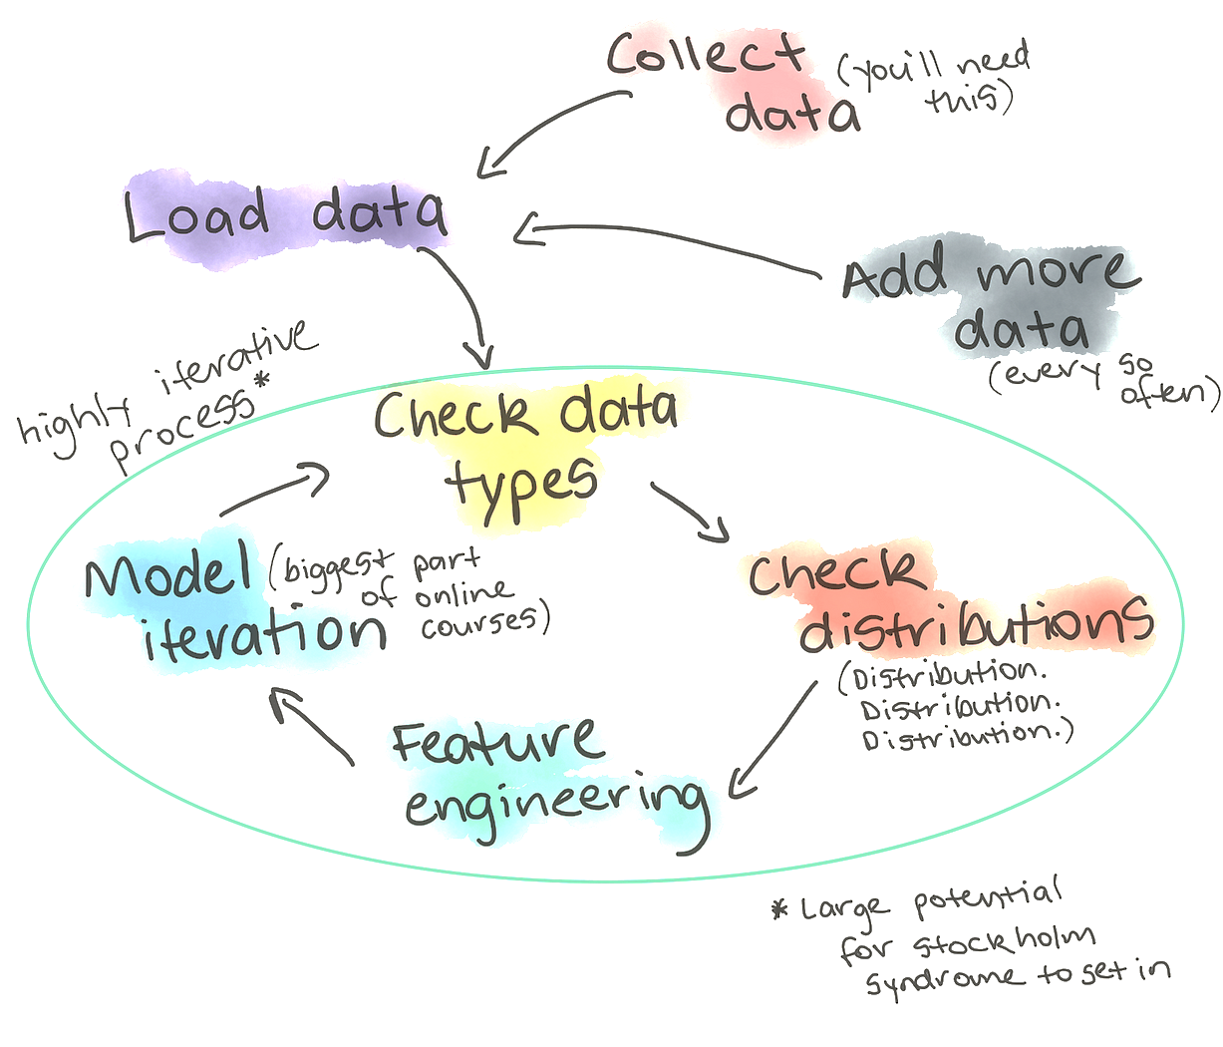
Exploratory Data Analysis (EDA) s used by data scientists to analyze and investigate data sets and summarize their main characteristics, often employing data visualization methods.
It helps determine how best to manipulate data sources to get the answers you need, making it easier for data scientists to discover patterns, spot anomalies, test a hypothesis, or check assumptions
It was originally developed by American mathematician John Tukey in the 1970s

Slide 6
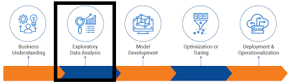
Why is exploratory data analysis important in data science?
The main purpose of EDA is to help look at data before making any assumptions
It can help identify obvious errors, as well as better understand patterns within the data, detect outliers or anomalous events, find interesting relations among the variables
Data Scientists can use exploratory analysis to ensure the results they produce are valid and applicable to any desired outcomes and goals.
Once EDA is complete and insights are draws, its features can then be used for more sophisticated data analysis or modelling, including machine learning

Slide 7
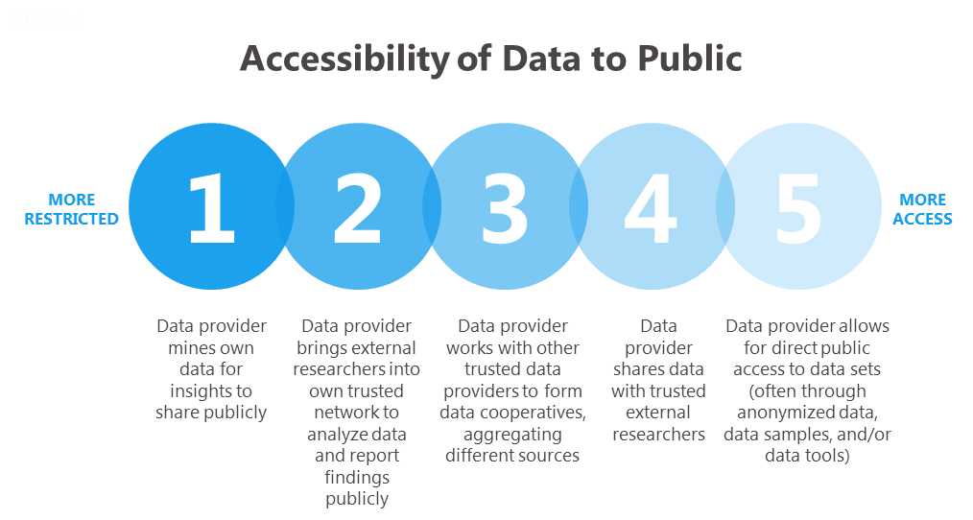
PUBLIC – PRIVATE DATA
Private data is collected by private companies and is not generally available to the public
Advantages:
More specific and relevant to particular analyst
More timely than public data
Less subject to privacy restrictions
Disadvantages:
Not free to use
Difficult to obtain or access
Public data is typically collected by government agencies or other public institutions and is available to anyone who wants to use it.
Advantages:
Large and Comprehensive
Timely
Free to use – Cost Efficient
Disadvantage:
Quality Issues
Not relevant to particular analyst
Privacy restrictions (if applicable)

Slide 8

demonstration of importing dataset from various sources to the jupyter Importing Dataset

Slide 9

Web Scrapping
Web scraping is the process of using a computer program to extract data from a website. This data can be in the form of text, images, or other forms of data. Web scraping is often used to collect data for research, data analysis, or to create a new product or service.
Python is a popular programming language that can be used for web scraping. There are many Python libraries that make web scraping easy, such as Beautiful Soup and Requests.
Web Scraping Implementation

Slide 10
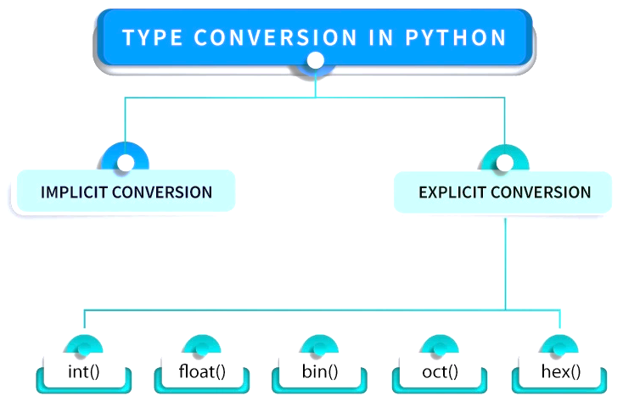
Data types and its conversion
Data types define the type of data that a variable can hold.
Python is dynamically typed, which means you don't need to explicitly declare the data type of a variable; it's determined at runtime.
There are three different methods to convert datatypes:
pd.to_DATATYPE(df[‘column_name’])
df[‘column_name’].astype(‘DATATYPE’)
df[‘column_name’].apply(lambda …..)

Slide 11
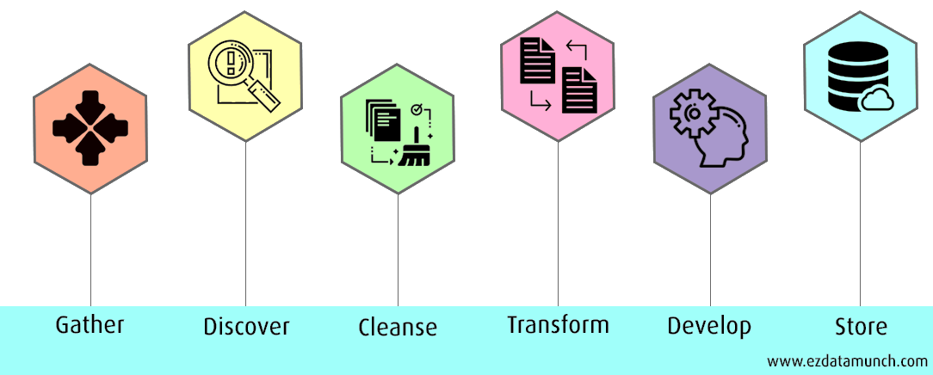
transforming and preparing the data with the right data types using conversion function
implementation

Slide 12
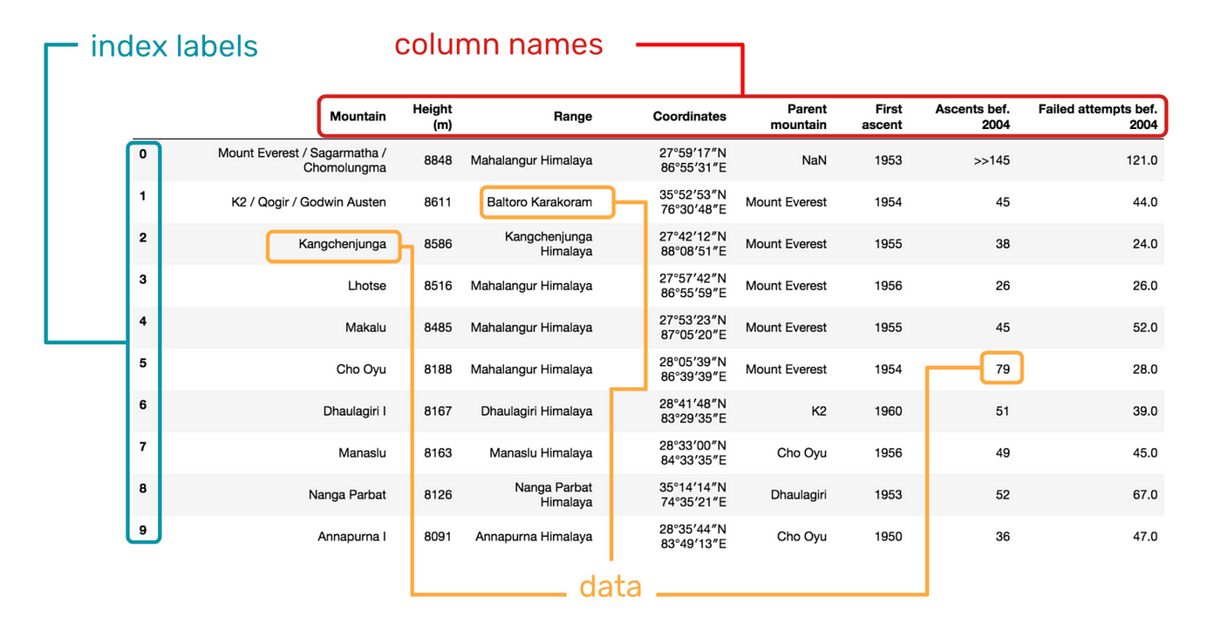
Fixing the rows and columns
Fixing rows and columns in a dataset typically involves data preprocessing tasks, such as
removing or handling missing values
filtering rows based on certain conditions
renaming columns
reorganizing the data structure.
IMPLEMENTATION

Slide 13
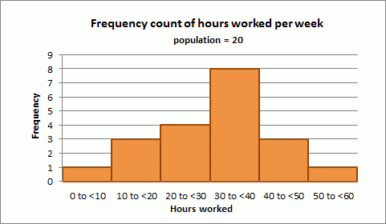
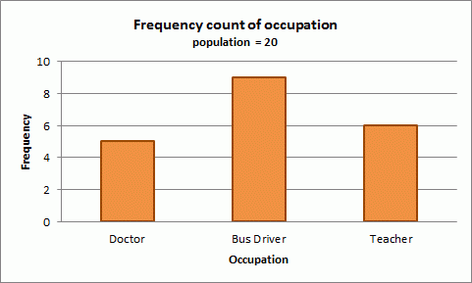
Quantity and distribution of data
Quantitative data is data that can be counted or measured in numerical values
E.g., Height in feet, Age in years, and weight in pounds
Qualitative data is the measure of “types” and may represent by name, symbol, or a number code. These are generally categorical variables (E.g., What type)
It is important to identify whether the data are quantitative or qualitative as this affects the statistics that can be produced.
Quantitative Data – Descriptive Summary Statistics (numerical)
Qualitative Data – Inferential Statistics

Slide 14
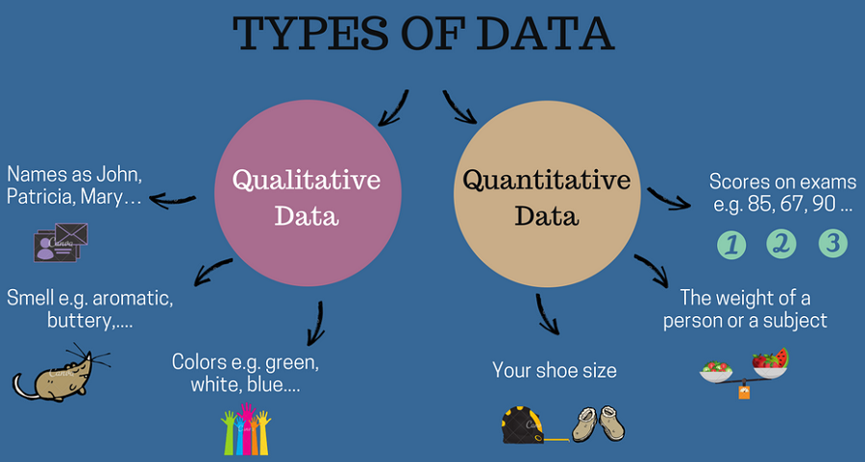
The distribution of a statistical dataset is the spread of the data which shows all possible values or intervals of the data and how they occur
The distribution provides a parameterized mathematical function which will calculate the probability of any individual observation from the sample space

Slide 15

analysis of quantity and distribution of data and understanding it by interpreting the columns
IMPLEMENTATION

Slide 16
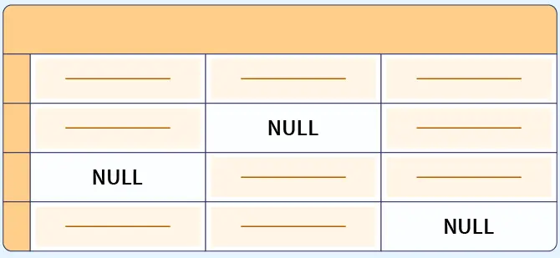
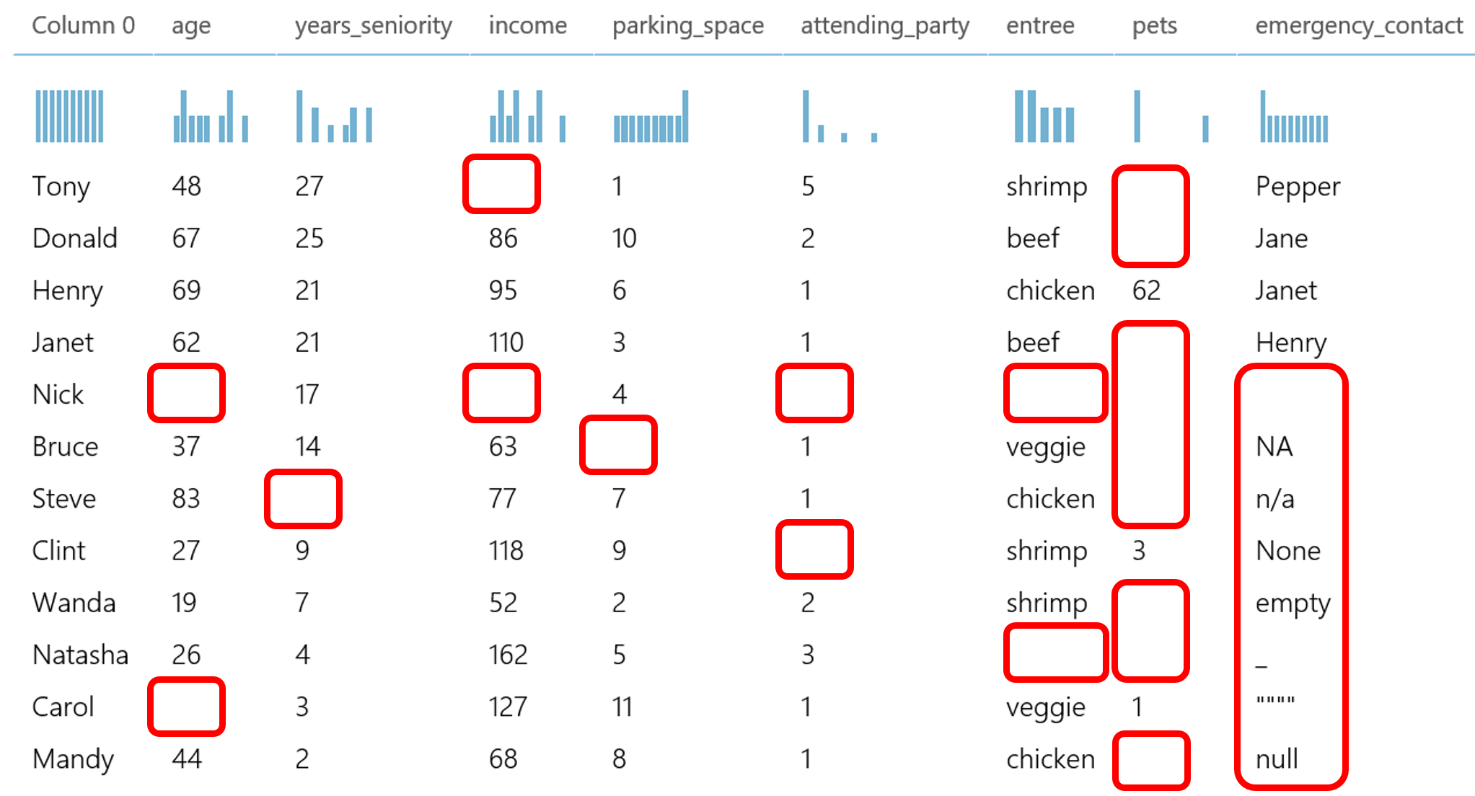
impute or remove missing values
Missing values are data points in a dataset that do not have an assigned value or information for a particular feature (variable) or observation (row).
These missing values are often represented by special placeholders like "NaN" (Not-a-Number), "None," or simply left blank.
Handling missing values is a critical step in data preprocessing, as they can adversely affect the quality and reliability of your analyses and machine learning models
Deletion:
Listwise Deletion – remove entire row with missing values
Column Deletion – remove entire column (feature) with high percentage of missing values
Imputation:
Replace it with measures of central tendance (Mean, Median, and Mode)
Forward Fill or Backward Fill (time series data)
Linear Interpolation
Missing Value Indicators – preserve information about the presence of missing values
Domain-specific Imputation – domain knowledge or external data sources to impute
IMPLEMENTATION

Slide 17
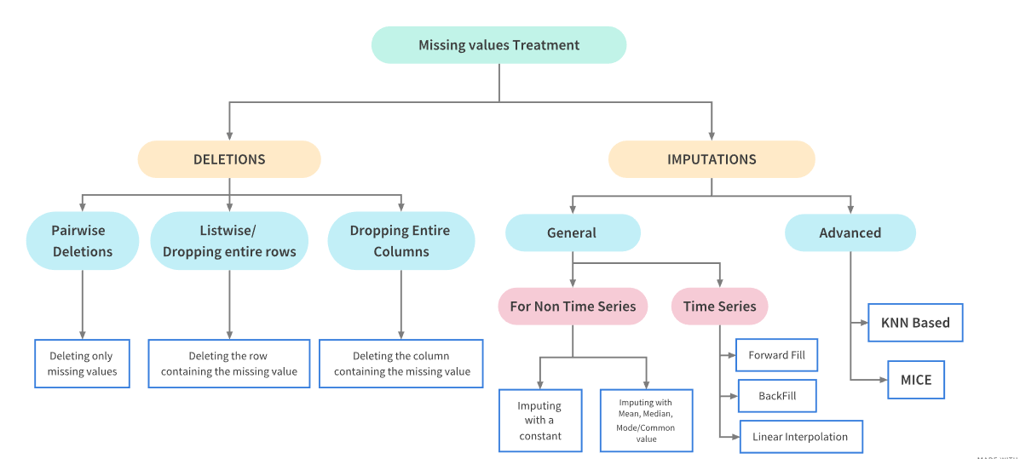
analysis of data quality issues and perform various techniques for missing value imputation
Missing Value Imputation – Bank Dataset

Slide 18
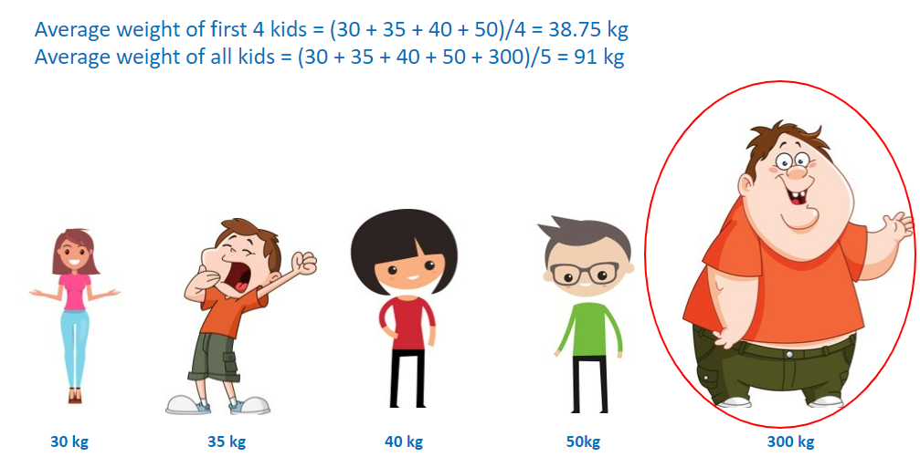
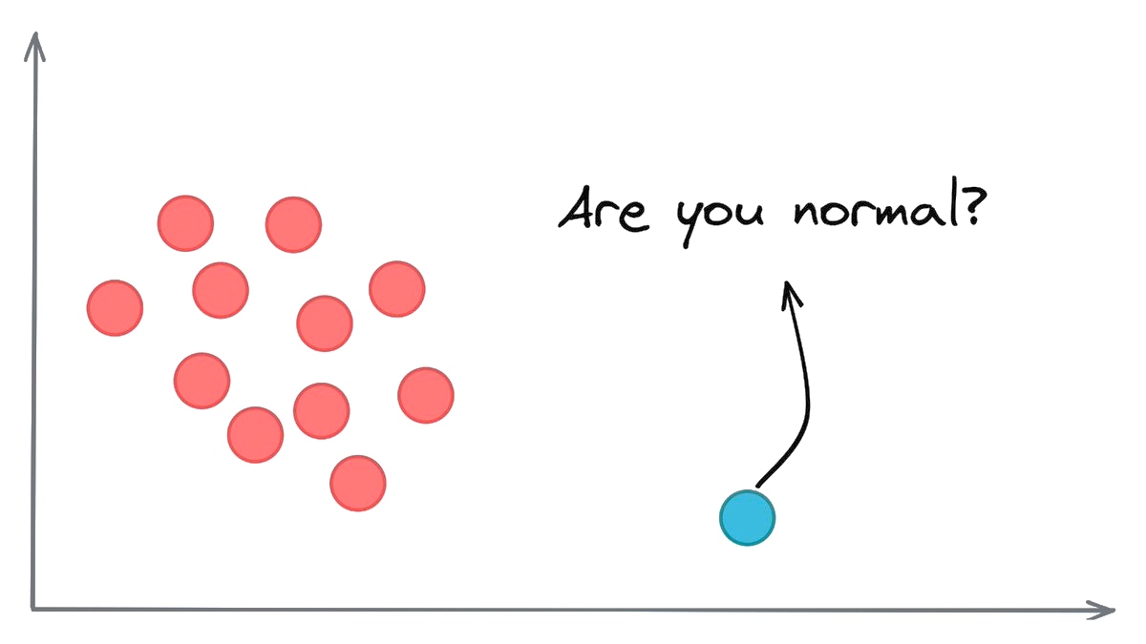
Handling outliers
Outliers are data points that significantly differ from the majority of data points in a dataset.
They are observations that are distant from other observations and can be either unusually high (positive outliers) or unusually low (negative outliers) with respect to the central tendency of the data.
Outliers can occur due to various reasons, including data entry errors, measurement errors, natural variation, or rare events.
Identify and Visualize Outliers – boxplots, scatter plots
IQR Method
Z-Score Method
Visualization and Domain Knowledge – Validation

Slide 19
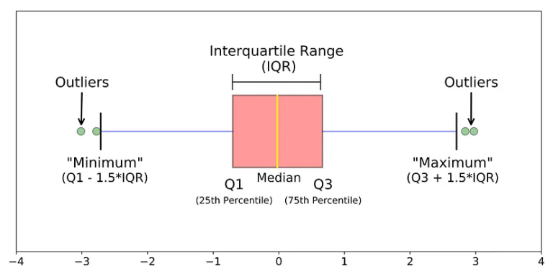
.. Using boxplot (iqr method)
This method helps evaluating the data into quartiles (25% percentile, 50% percentile and 75% percentile ).
We calculate the interquartile range (IQR) and identify the data points that lie outside the range.
Formula to calculate the upper and lower data limits is as follows:
Lower range limit = Q1 – (1.5* IQR)
Higher range limit = Q3 + (1.5*IQR)
plt.boxplot()
pandas.quantile()

Slide 20
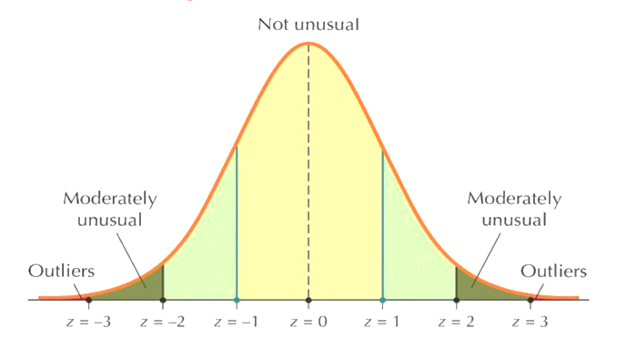
.. Using z-score (distribution)
A z-score is a statistical measurement that describes how far a data point is from the mean of a group of values.
It is also known as standard score
The formula for calculating a z-score is:
z = (x − μ)/ σ Where x is the test value, μ is the mean, and σ is the standard value.

Slide 21

understanding the data outliers and remove duplicates and irrelevant data from the database
OUTLIERS - BOSTON

Slide 22
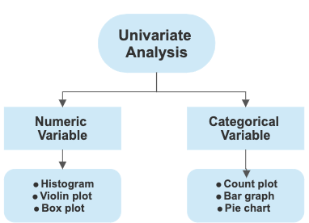
INTRODUCTION TO UNIVARIATE ANALYSIS
Univariate analysis is a statistical method used to analyze and describe the distribution, patterns, and characteristics of a single variable (or feature) within a dataset
It focuses on examining one variable at a time without considering the relationships or interactions with other variables
Univariate analysis provides a fundamental understanding of individual variables and helps in exploring their properties
Key objectives of Univariate Analysis:
Descriptive Statistics
Visualization
Frequency Distribution
Measuring Central Tendency
Measuring Dispersion
Measuring Skewness and Kurtosis
Testing of Normality
Outlier Detection
Summary Statistics

Slide 23
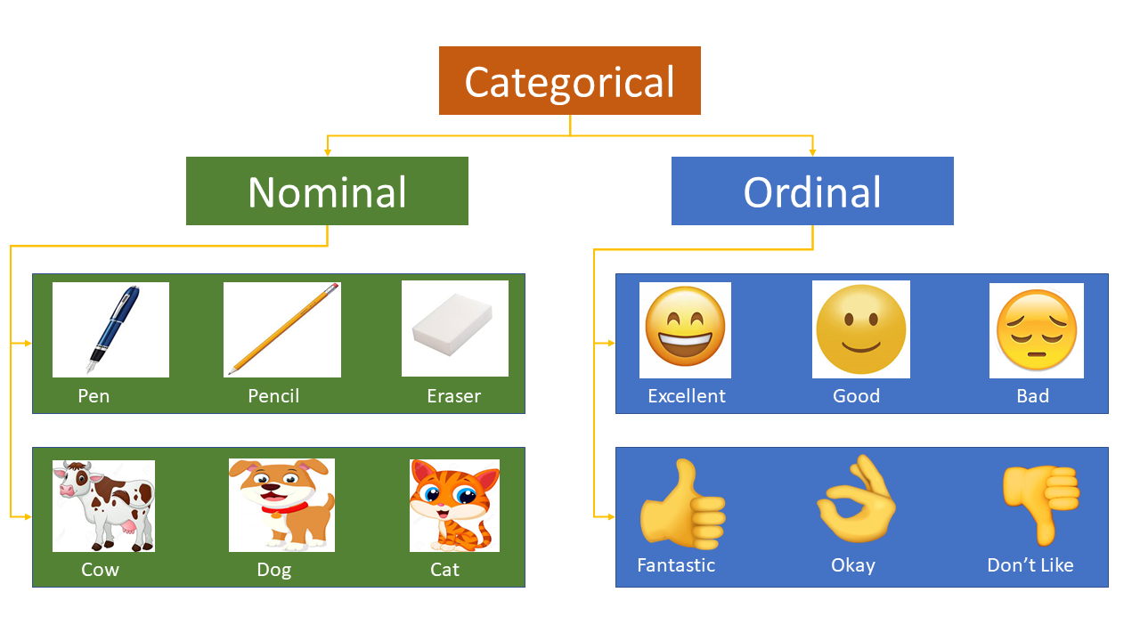
Categorical univariate
UNORDERED (NOMINAL)
ORDERED (ORDINAL)
In this type of analysis, the categorical variable does not have an inherent order or hierarchy among its categories
The categories are nominal, meaning they are labels without any specific order
Examples of nominal categorical variables include gender (e.g., "Male," "Female"), colors (e.g., "Red," "Blue," "Green"), or types of fruits (e.g., "Apple," "Banana," "Orange").
Univariate Tasks:
Frequency Distribution
Creating Bar Charts or Pie Charts
Identifying Mode (most frequent category)
In this type of analysis, the categorical variable has an inherent order or ranking among its categories. These categories can be ranked or ordered in a meaningful way.
Examples of ordinal categorical variables include education levels (e.g., "High School," "Bachelor's," "Master's," "Ph.D."), customer satisfaction levels (e.g., "Very Dissatisfied," "Dissatisfied," "Neutral," "Satisfied," "Very Satisfied")
Univariate Tasks:
Frequency Distribution
Bar Charts or Histograms
Measuring Central Tendency and Variability

Slide 24

Performing univariate analysis cars dataset
ORDERED-UNORDERED

Slide 25
Bivariate Analysis
Bivariate analysis is a statistical analysis technique that involves the simultaneous examination and analysis of two variables to understand the relationships, associations, or interactions between them
Unlike univariate analysis, which focuses on a single variable, bivariate analysis explores how two variables relate to each other and provides insights into their joint behavior
Types of bivariate analysis:
Numerical – Numerical: Correlation or Association, Scatter Plots, correlation coefficient. E.g., Analyzing the relationship between a person’s age and their income
Categorical – Categorical: Exploring association or dependency between nominal or ordinal variables/ Chi-squared test, contingency tables. E.g., Studying the relationship between gender (Male/Female) and voting preference (Democrat/Republican/Independent)
Categorical – Numerical: Boxplots, t-test, ANOVA (Analysis of Variance). E.g., Analysing the relationship between stock prices of two companies over time

Slide 26
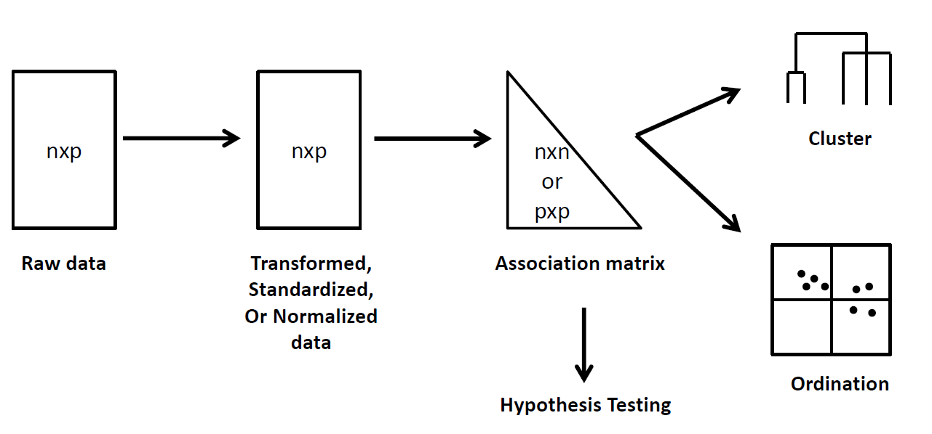
Multivariate analysis
Multivariate analysis is a statistical and data analysis technique that involves the simultaneous analysis of two or more variables to understand the relationships, patterns, and interactions among them.
Unlike univariate analysis (which deals with a single variable) and bivariate analysis (which examines the relationships between two variables), multivariate analysis deals with multiple variables
It is a powerful approach used to uncover complex patterns, make predictions, and gain deeper insights into data.

Slide 27

Performing bivariate and multivariate analysis
IMPLEMENTATION

Slide 28
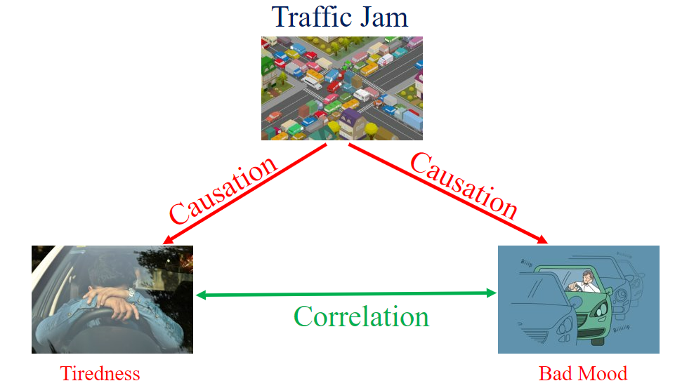
Correlation - causation
Correlation and Causation are both statistical terms that describe the relationship between two variables
Correlation is the degree of association between two variables, it simple indicates that when one variable changes, there is a tendency for the other variable to change in a certain direction
Causation refers to a cause-and-effect relationship between two variables, where one variable (the independent variable) influences or brings about a change in another variable (the dependent variable)
Correlation does not imply Causation!
For example, Analyzing data on ice cream sales and drowning incidents over several months in a costal town
Correlation: There is a positive correlation between ice cream sales and drowning incidents, but this does not imply that one causes the other
Causation: Temperature is the underlying factor influencing both ice cream sales and drowning incidents. The relationship between ice cream and drowning is not a direct casual one.

Slide 29
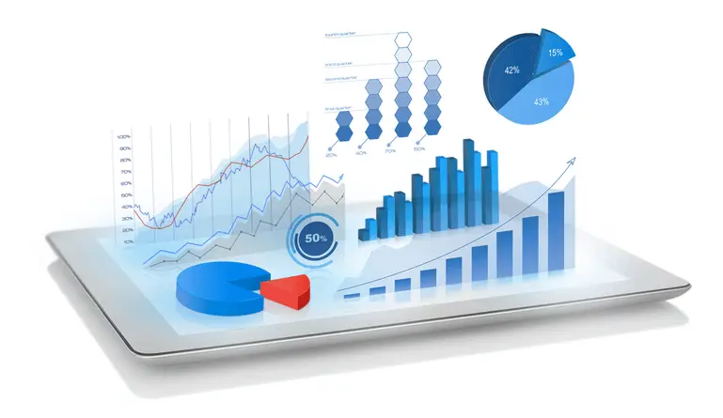
Data visualization
Data visualization is the graphical representation of data to help people understand and make sense of information.
It involves the use of visual elements like charts, graphs, maps, and infographics to convey data patterns, trends, and insights.
Effective data visualization can make complex data more accessible, aiding in decision-making and storytelling
IMPLEMENTATION

